Slide 1

Disease Detection from Chest X-ray Images Using Deep Learning
Adithya Asokan and Subhan Ahmad
Faculty Mentor: Professor Ole Forsberg
Funding: Richter Memorial Fund
01

Slide 2
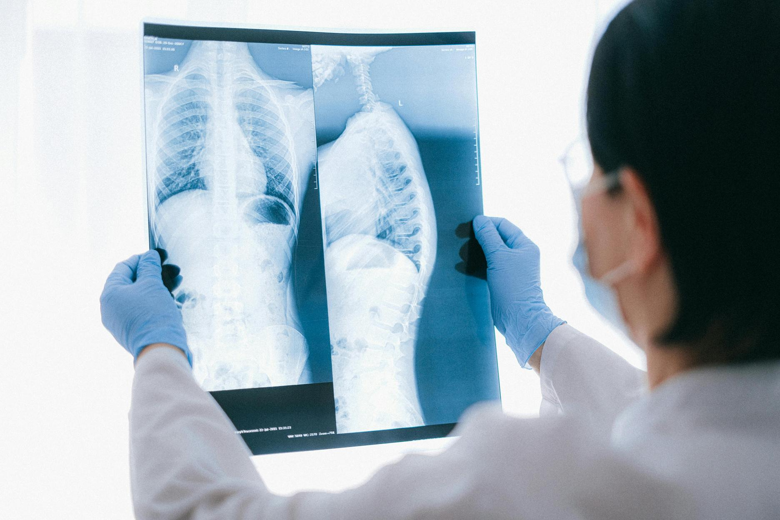
Can AI detect disease from a simple X-ray?"
Scalable diagnosis in low-resource settings
02

Slide 3
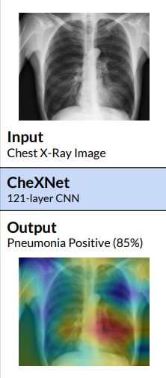
Literature Review
CheXNet (Rajpurkar et al., 2017)
A 121-layer DenseNet trained on the ChestX-ray14 dataset (over 100,000 images, 14 diseases).
Surpassed average radiologist performance in detecting pneumonia, achieving an F1-score of 0.435 compared to the average radiologist F1 of 0.387.
Used Class Activation Maps (CAMs) to provide visual explanations for predictions.
What We Add
Used two datasets (NIH ChestX-ray14 + Kaggle's pneumonia dataset) for cross-domain evaluation.
Integrated Grad-CAM extensively — not just to explain predictions, but also to analyze misclassified cases.
09

Slide 4
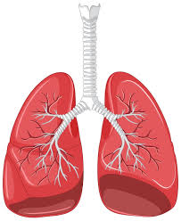
Research Question
How accurately can deep learning classify X-rays into NORMAL or PNEUMONIA?
03

Slide 5
Datasets
Kaggle Dataset (Guangzhou Medical Center): Balanced pneumonia/normal images
# === 1. Load Full Dataset ===
train_ds = tf.keras.preprocessing.image_dataset_from_directory(
'./data/chest_xray/chest_xray/train',
validation_split=0.3,
subset='training',
seed=123,
image_size=(224, 224),
batch_size=32
)
val_ds = tf.keras.preprocessing.image_dataset_from_directory(
'./data/chest_xray/chest_xray/train',
validation_split=0.3,
subset='validation',
seed=123,
image_size=(224, 224),
batch_size=32
)
04

Slide 6
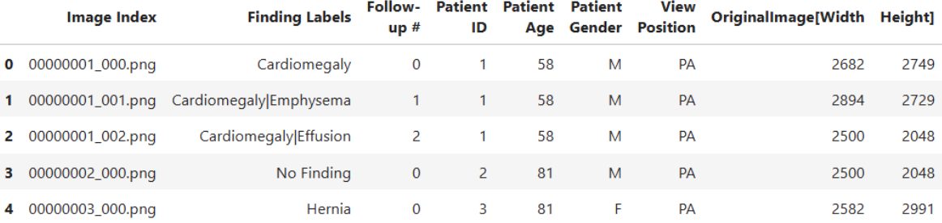
Datasets
NIH ChestX-ray14: 2881 images, US-based
import pandas as pd
import os
# Set path to the downloaded dataset
dataset_path = '/home/jovyan/.cache/kagglehub/datasets/nih-chest-xrays/data/versions/3'
# Load metadata
csv_path = os.path.join(dataset_path, 'Data_Entry_2017.csv')
df = pd.read_csv(csv_path)
# View basic info
print("Number of images:", len(df))
print("Unique diseases:", df['Finding Labels'].str.split('|').explode().nunique())
print("Sample labels:", df['Finding Labels'].unique()[:5])
df.head()
Unique labels in the NIH Chest X-ray dataset:
- Atelectasis
- Cardiomegaly
- Consolidation
- Edema
- Effusion
- Emphysema
- Fibrosis
- Hernia
- Infiltration
- Mass
- No Finding
- Nodule
- Pleural_Thickening
- Pneumonia
- Pneumothorax
04

Slide 7
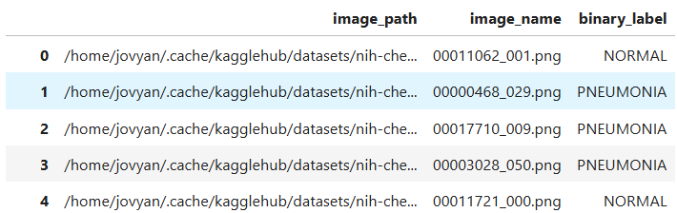
Datasets
NIH ChestX-ray14: 2881 images, US-based
# Load NIH labels and map to binary
def binary_label(finding):
if 'Pneumonia' in finding:
return 'PNEUMONIA'
elif finding.strip() == 'No Finding':
return 'NORMAL'
return None
label['binary_label'] = label['label'].apply(binary_label)
balanced_df = label.dropna(subset=['binary_label'])
04

Slide 8
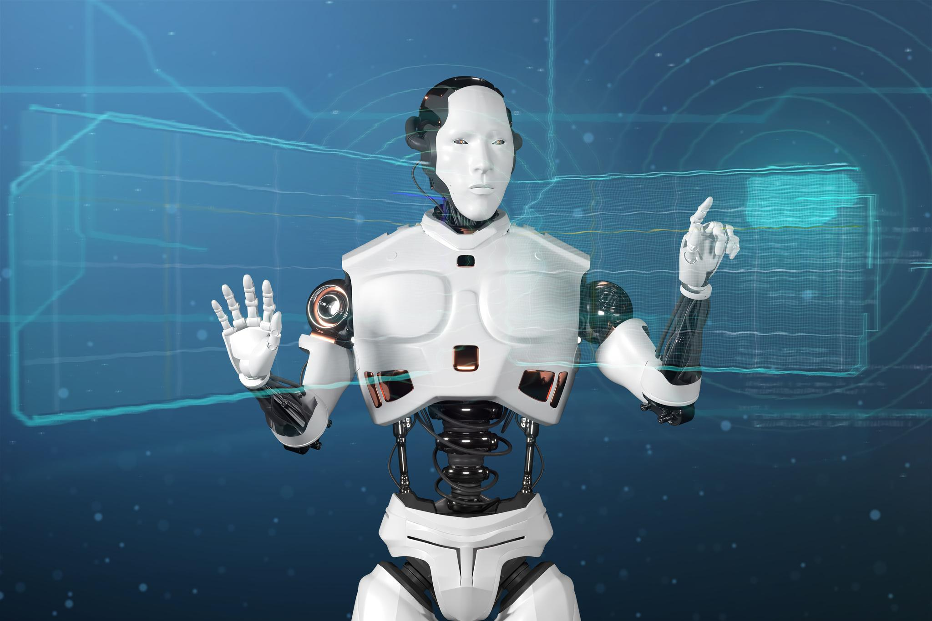
Preprocessing
def load_image(path, label):
image = tf.io.read_file(path)
image = tf.image.decode_png(image, channels=3)
image = tf.image.resize(image, [224, 224])
image = image / 255.0
return image, label
train_ds = tf.data.Dataset.from_tensor_slices((paths, labels))
train_ds = train_ds.map(load_image).batch(32).prefetch(tf.data.AUTOTUNE)
224x224 resizing, normalization
Augmentation: flip, rotate, zoom
Balanced classes (e.g., 1450 normal samples)
05

Slide 9
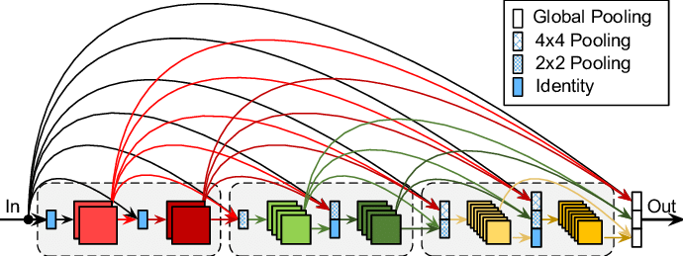
Model Architecture
base_model = DenseNet121(include_top=False, weights='imagenet', input_shape=(224, 224, 3))
base_model.trainable = False
model = tf.keras.Sequential([
base_model,
tf.keras.layers.GlobalAveragePooling2D(),
tf.keras.layers.Dense(128, activation='relu'),
tf.keras.layers.Dropout(0.5),
tf.keras.layers.Dense(1, activation='sigmoid')
])
Block diagram: DenseNet121 → GAP → Dense → Dropout → Sigmoid
Transfer learning (ImageNet weights)
06

Slide 10

Training Details
Binary cross-entropy loss
Adam optimizer (lr=1e-5)
Early stopping, ReduceLROnPlateau
Class weights
model.compile(
optimizer=tf.keras.optimizers.Adam(1e-5),
loss='binary_crossentropy',
metrics=['accuracy']
)
history = model.fit(
train_ds,
validation_data=val_ds,
epochs=30,
class_weight=class_weights,
callbacks=[early_stop, reduce_lr]
)
07

Slide 11
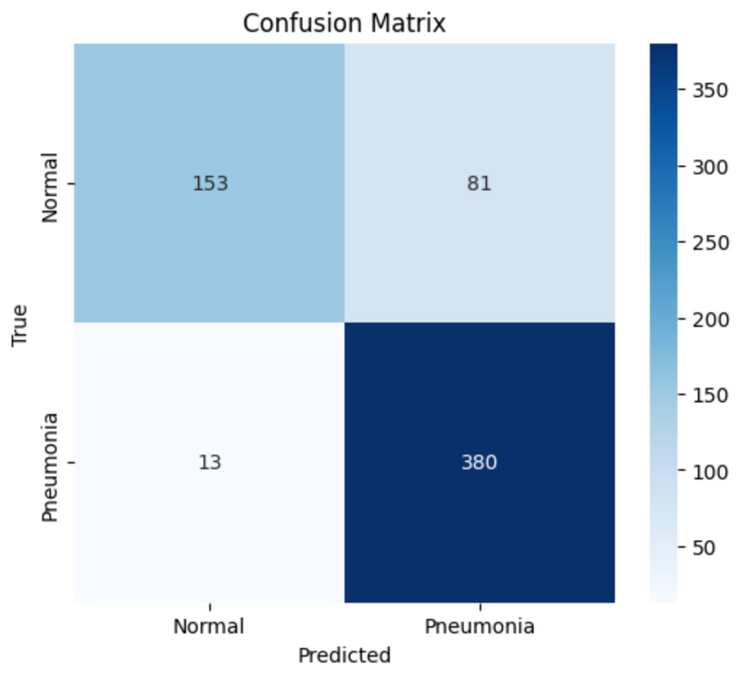
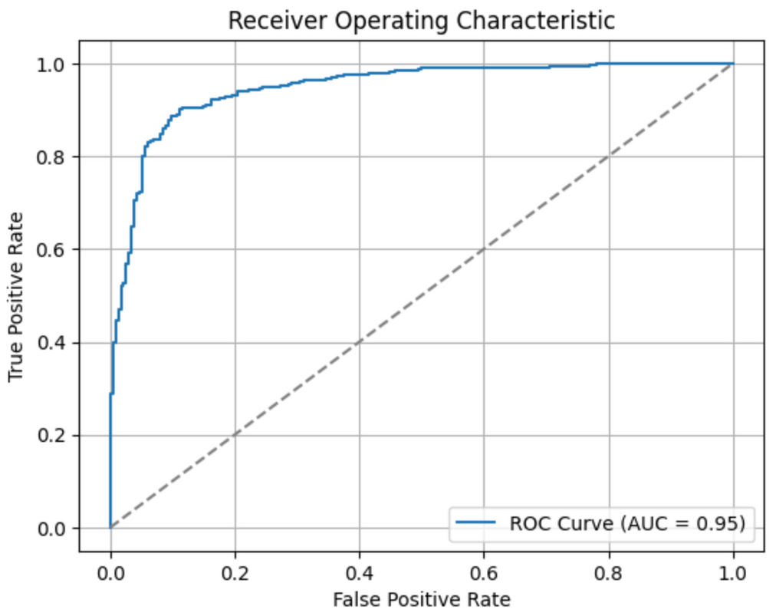
Results (Kaggle Model)
# Confusion matrix
cm = confusion_matrix(y_true, y_pred)
sns.heatmap(cm, annot=True, fmt='d', cmap='Blues'
# ROC Curve
fpr, tpr, _ = roc_curve(y_true, y_probs)
plt.plot(fpr, tpr, label=f'AUC = {roc_auc:.2f}')
06

Slide 12
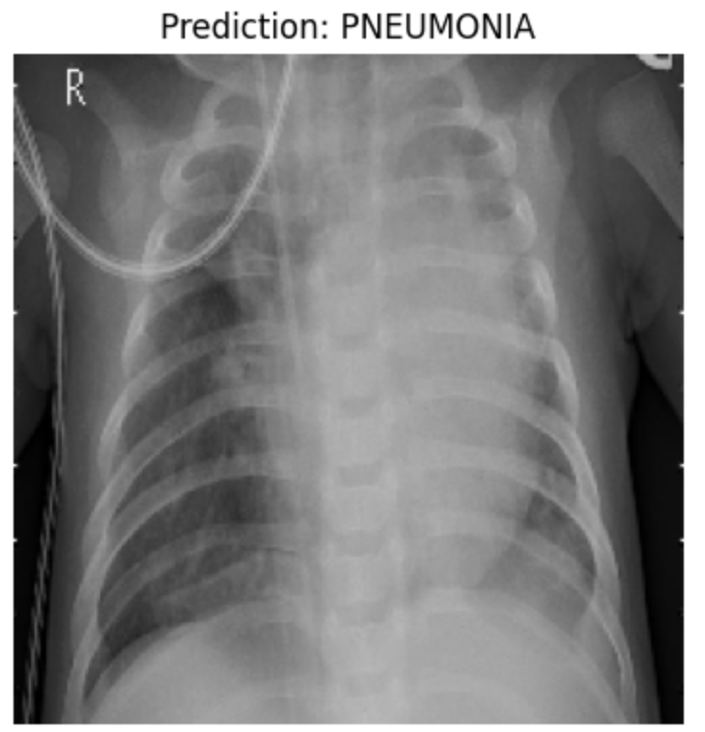
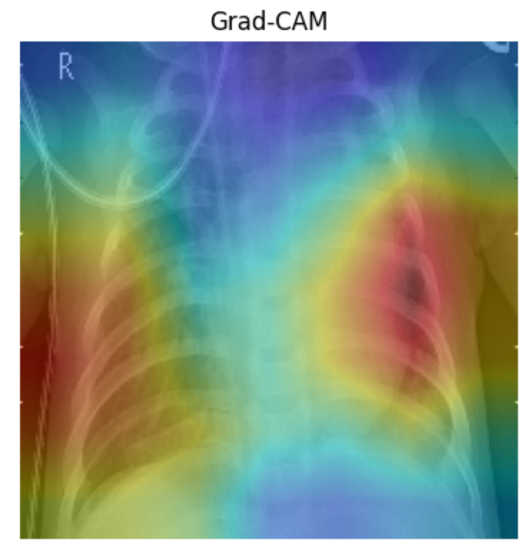
Results (Kaggle Model)
06

Slide 13
Results (Kaggle Model)
Classification Report
Class | Precision | Recall | F1-Score | Support
Normal | 0.92 | 0.65 | 0.77 | 234
Pneumonia | 0.82 | 0.97 | 0.89 | 393
Accuracy |  |  | 0.85 | 627
Macro Avg | 0.87 | 0.81 | 0.83 | 627
Weighted Avg | 0.86 | 0.85 | 0.84 | 627
06

Slide 14
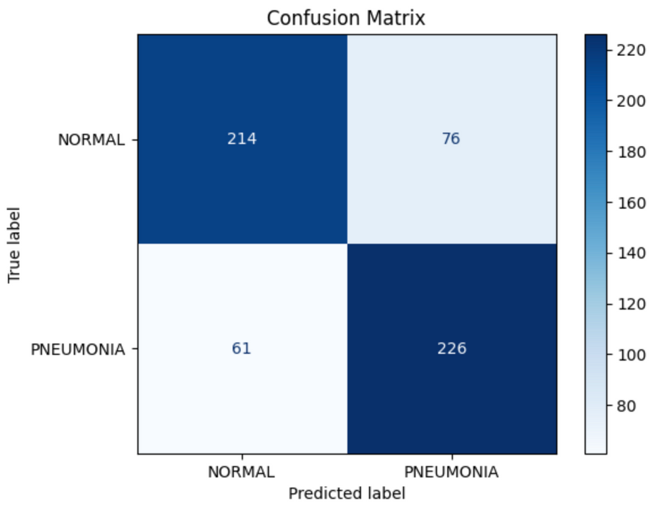
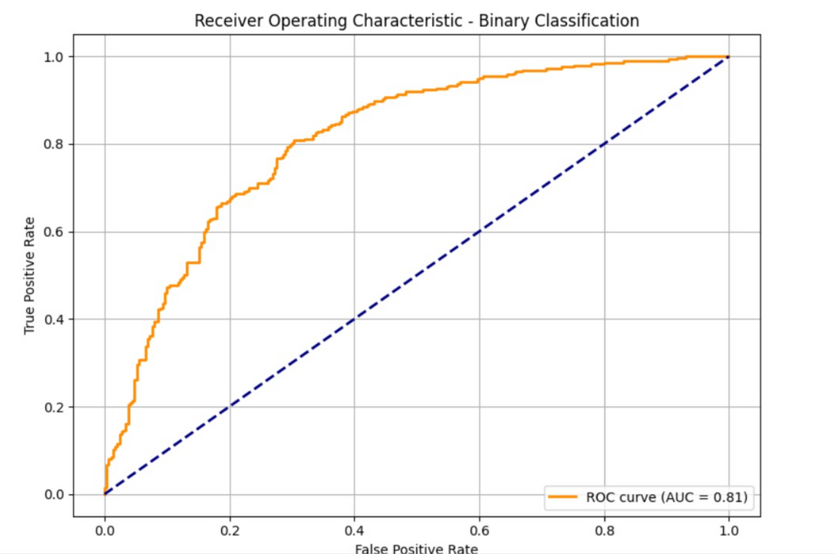
Results (NIH Model)
06

Slide 15
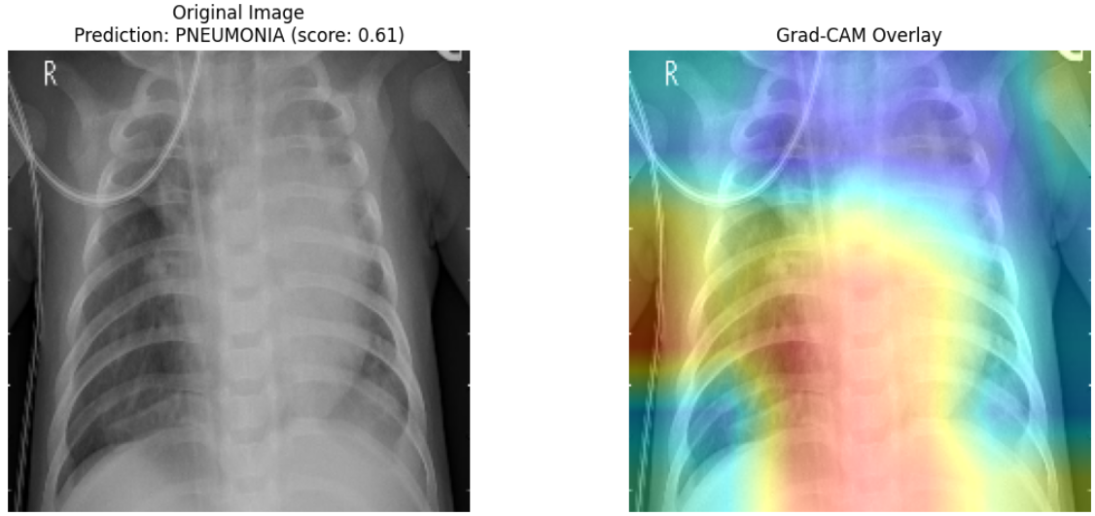
Results (NIH Model)
06

Slide 16
Results (NIH Model)
Classification report
Class | Precision | Recall | F1-Score | Support
NORMAL | 0.78 | 0.74 | 0.76 | 290
PNEUMONIA | 0.75 | 0.79 | 0.77 | 287
Accuracy |  |  | 0.76 | 577
Macro Avg | 0.76 | 0.76 | 0.76 | 577
Weighted Avg | 0.76 | 0.76 | 0.76 | 577
06

Slide 17
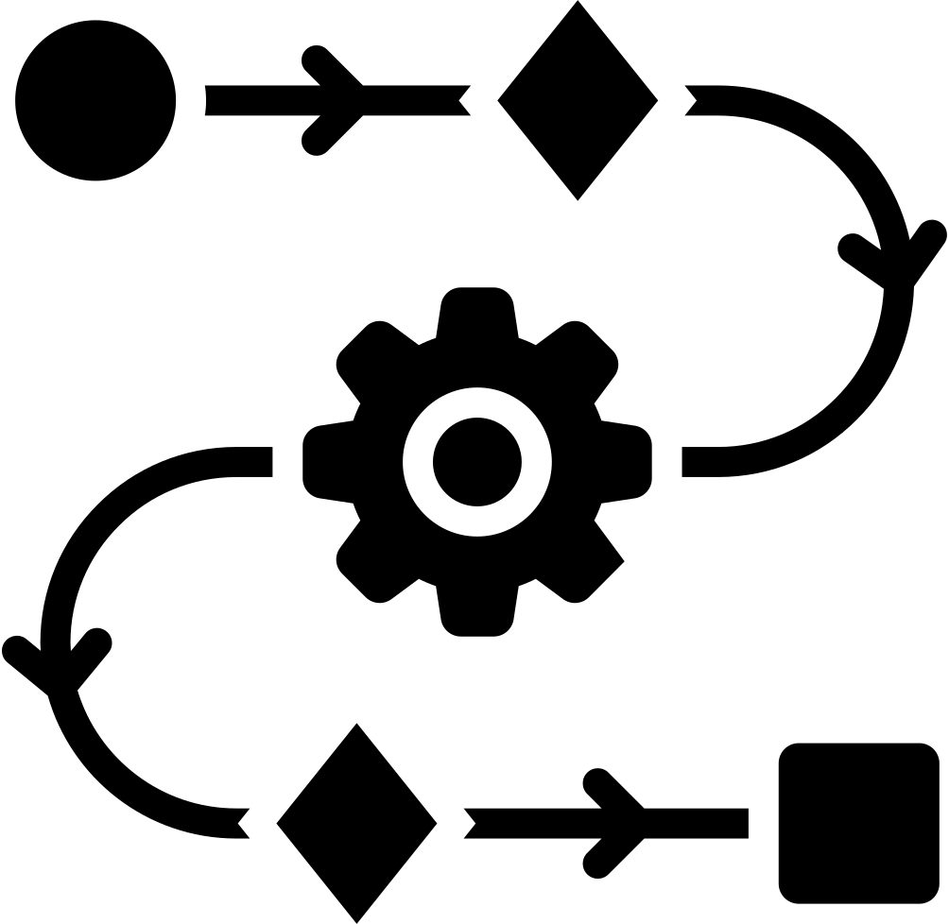
Analysis & Future Work
Class imbalance in NIH dataset (more pneumonia cases)
Noisy labels from automated report extraction
Lower recall for "Normal" class due to skewed training
Tune prediction threshold using ROC/F1 to optimize clinical performance
Implement multi-label classification (detect multiple conditions per image)
Integrate Med-GEMMA for vision-language reasoning and report generation
Expand dataset with CheXpert, MIMIC-CXR, RSNA for better generalization
Fine-tune model on balanced datasets for improved reliability
06

Slide 18

Conclusion
Used NIH and Kaggle (Guangzhou) chest X-ray datasets
Kaggle dataset (balanced) gave better performance than NIH (imbalanced, noisy)
Achieved up to 85% accuracy on validation set
Integrated Grad-CAM for model explainability
Model focused on clinically relevant lung regions
Shows potential for AI-assisted diagnosis in real-world use cases
06

Slide 19


Thank You For Watching and ask any questions
10

